Slide 1
NIELIT SUMMER INTERN 2021
COURSE:
ANDROID DEVELOPMENT
NAME:
FARHAN HUSSAIN
PROJECT NAME:
THE ULTIMATE QUIZ

Slide 2
CODE EDITOR AND LANGUAGES USED :
ANDROID STUDIO
JAVA
eXtensive Markup Language

Slide 3
FEATURES:
TESTS YOUR GENERAL KNOWLEDGE IN GAMES

Slide 4
DESCRIPTION:
This Android project Accompanies the use of Linear layout (vertical) as well as using Image view and Buttons.
This consists of one LinerLayout that has ImageView, TextView and three Buttons as its children.
The UI of the Application is coded using EXtensive Markup language

Slide 5
And at last, For a correct answer selected in the quiz, There shows a Toast message. And another toast message is shown when a wrong answer is selected.

Slide 6
SCREENSHOTS OF APPLICATION

Slide 7
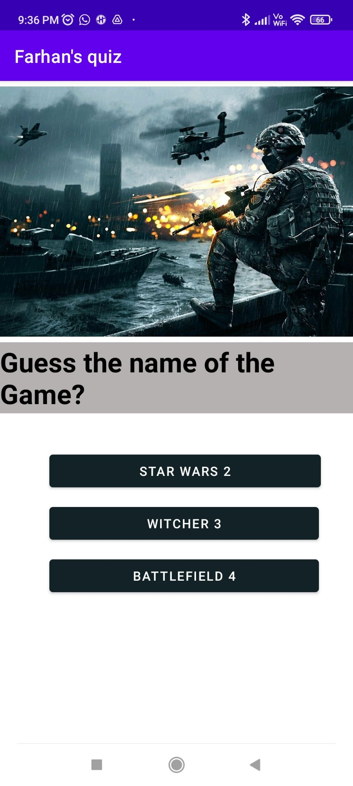

Slide 8
SOURCE CODES of Java file
package com.example.quiz;
import androidx.appcompat.app.AppCompatActivity;
import android.os.Bundle;
import android.view.View;
import android.widget.Button;
import android.widget.Toast;
public class MainActivity extends AppCompatActivity {
private String result = "Battlefield 4";
private Button choice1;
private Button button2;
private Button choice3;
private void showToastMessage(boolean showToastMessage)
{
if (showToastMessage) Toast.makeText(this, "Correct mann", Toast.LENGTH_SHORT).show();
else
Toast.makeText(this, "Whoops Try again", Toast.LENGTH_SHORT).show();
}
@Override
protected void onCreate(Bundle savedInstanceState) {
super.onCreate(savedInstanceState);
setContentView(R.layout.activity_main);
choice1 = (Button) findViewById(R.id.button);
button2 = (Button) findViewById(R.id.button2);
choice3 = (Button) findViewById(R.id.button3);
choice1.setOnClickListener(new View.OnClickListener() {
@Override
public void onClick(View v) {
if (choice1.getText().equals(result))
showToastMessage(true);
else
showToastMessage(false);
}
});
button2.setOnClickListener(new View.OnClickListener() {
@Override
public void onClick(View v) {
if (button2.getText().equals(result))
showToastMessage(true);
else
showToastMessage(false);
}
});
choice3.setOnClickListener(new View.OnClickListener() {
@Override
public void onClick(View v) {
if (choice3.getText().equals(result))
showToastMessage(true);
else
showToastMessage(false);
}
});
}
}

Slide 9
SOURCE CODE of XML file
<?xml version="1.0" encoding="utf-8"?>
<androidx.constraintlayout.widget.ConstraintLayout xmlns:android="http://schemas.android.com/apk/res/android"
xmlns:app="http://schemas.android.com/apk/res-auto"
xmlns:tools="http://schemas.android.com/tools"
android:layout_width="match_parent"
android:layout_height="match_parent"
tools:context=".MainActivity">
<LinearLayout
android:layout_width="match_parent"
android:layout_height="match_parent"
android:orientation="vertical"
app:layout_constraintBottom_toBottomOf="parent"
app:layout_constraintEnd_toEndOf="parent"
app:layout_constraintHorizontal_bias="0.0"
app:layout_constraintStart_toStartOf="parent"
app:layout_constraintTop_toTopOf="parent"
app:layout_constraintVertical_bias="0.0">
<ImageView
android:id="@+id/imageView"
android:layout_width="match_parent"
android:layout_height="290dp"
app:srcCompat="@drawable/_837983_battlefield4primegamingfree" />

Slide 10
<TextView
android:id="@+id/textView"
android:layout_width="match_parent"
android:layout_height="79dp"
android:background="#B5B1B1"
android:gravity="center_vertical"
android:text="Guess the name of the Game?"
android:textColor="#000000"
android:textSize="30sp"
android:textStyle="bold" />
<Button
android:id="@+id/button"
android:layout_width="302dp"
android:layout_height="wrap_content"
android:padding="8dp"
<TextView
android:id="@+id/textView"
android:layout_width="match_parent"
android:layout_height="79dp"
android:background="#B5B1B1"
android:gravity="center_vertical"
android:text="Guess the name of the Game?"
android:textColor="#000000"
android:textSize="30sp"
android:textStyle="bold" />
<Button
android:id="@+id/button"
android:layout_width="302dp"
android:layout_height="wrap_content"
android:padding="8dp"
android:text="Star Wars 2"
app:backgroundTint="#132227"
android:layout_marginLeft="55dp"
android:layout_marginTop="40dp"/>
<Button
android:id="@+id/button2"
android:layout_width="300dp"
android:layout_height="wrap_content"
android:layout_marginLeft="55dp"
android:text="Witcher 3"
app:backgroundTint="#132227"
android:layout_marginTop="10dp"/>
<Button
android:id="@+id/button3"
android:layout_width="300dp"
android:layout_height="wrap_content"
android:text="Battlefield 4"
app:backgroundTint="#132227"
android:layout_marginLeft="55dp"
android:layout_marginTop="10dp"/>
</LinearLayout>
</androidx.constraintlayout.widget.ConstraintLayout>

Slide 11
android:text="Star Wars 2"
app:backgroundTint="#132227"
android:layout_marginLeft="55dp"
android:layout_marginTop="40dp"/>
<Button
android:id="@+id/button2"
android:layout_width="300dp"
android:layout_height="wrap_content"
android:layout_marginLeft="55dp"
android:text="Witcher 3"
app:backgroundTint="#132227"
android:layout_marginTop="10dp"/>
<Button
android:id="@+id/button3"
android:layout_width="300dp"
android:layout_height="wrap_content"
android:text="Battlefield 4"
app:backgroundTint="#132227"
android:layout_marginLeft="55dp"
android:layout_marginTop="10dp"/>
</LinearLayout>
</androidx.constraintlayout.widget.ConstraintLayout>

Slide 12
WITH BEST REGARDS!!!

